Slide 1

PowerShell User Group
Southampton 25/09/2018
@PSSouthampton

Slide 2
agenda!
7.00pm - Arrival
7.15pm - Welcome / User Group Introduction - @jonathanmedd
7.30pm - Adventures in DevOps: Part 1 - Jonathan Medd - @jonathanmedd
8.15pm - Break / Pizza / Refreshments
8.45pm – Developing and Testing Cross Platform Compatible Modules with PowerShell Core - Mark Wragg- @markwragg
9.30pm - Wrap up / Close

Slide 3
Welcome and Practicalities
Fire exits
Respect our hosts
Deposit and Public Liability Insurance is on me
THANK YOU!

Slide 4
Thank you SPONSOR DevOpsGroup

Slide 5
User Group
Aim to meet roughly every 1 – 2 months
We have met every month Jan – Jun
Sep – today’s Meetup
Oct - Chris returns with a follow up to his GitHub 101 session back in June
Need 1 more presenter!
Nov - Craig Porteous and Paul Broadwidth
PowerShell Standards Agency
Git Fundamentals
Dec – social meetup TBD

Slide 6
Want to present?

Slide 7
We need!
Speakers
Some lined up, discussions ongoing
Topic ideas – we need to know what you want to hear about
GitHub 101
Azure PowerShell 101
PowerShell DSC

Slide 8
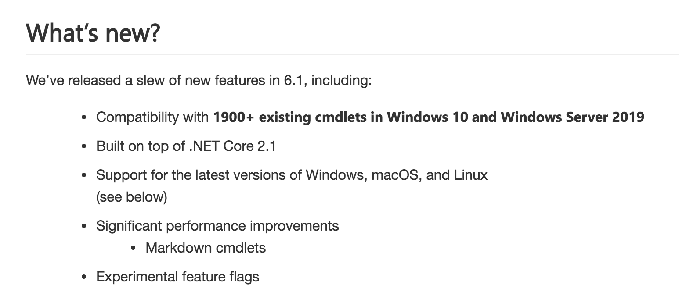
PowerShell News
PowerShell Core 6.1 release
https://blogs.msdn.microsoft.com/powershell/2018/09/13/announcing-powershell-core-6-1/

Slide 9
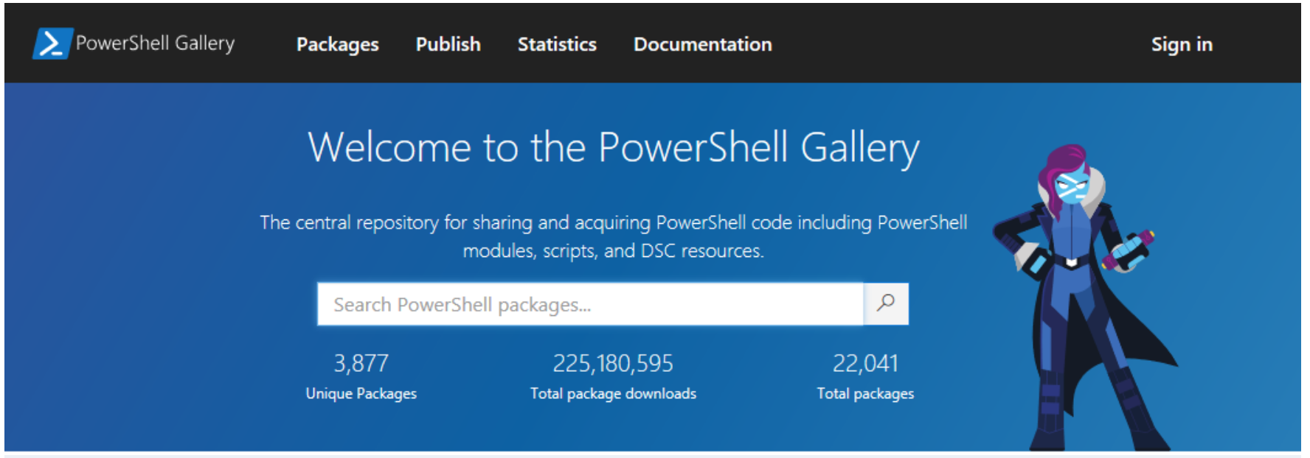
PowerShell News
New Look and Features for PowerShell Gallery
https://blogs.msdn.microsoft.com/powershell/2018/09/12/new-look-and-features-for-powershell-gallery/

Slide 10
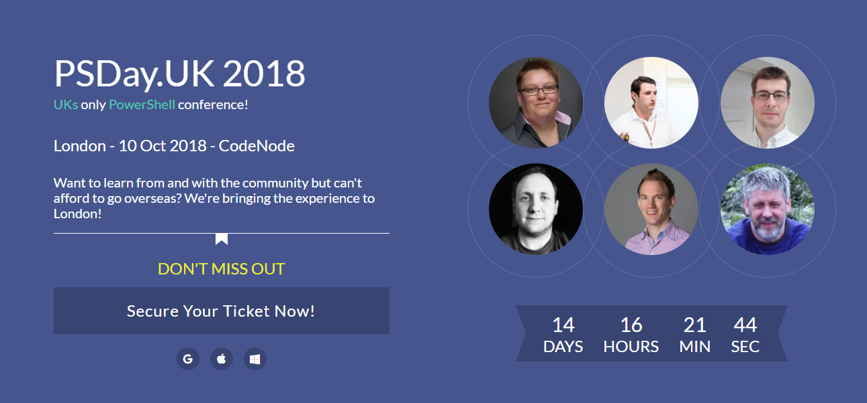
PSDAYUK 10th Oct 2018 – https://psday.uk

Slide 11
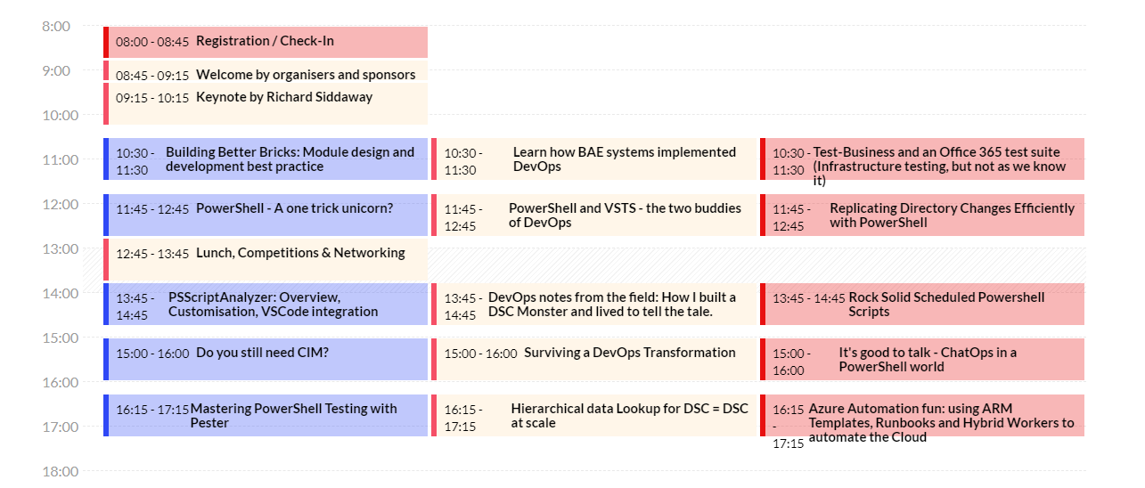
PSDAYUK 10th Oct 2018 – https://psday.uk

Slide 12
PSDAYUK 10th Oct 2018 – https://psday.uk
£25 off with code
PSUGSOUTH25
Last year’s content here:
https://www.youtube.com/playlist?list=PLLKI4jlvx_95iTr-0egDKiTCKCChnUTTW

Slide 13

Communication
Meetup.com - https://www.meetup.com/PowerShell-Southampton
Twitter - https://twitter.com/PSSouthampton
Slides and content will appear here: https://github.com/powershellorguk/SouthCoast

Slide 14
RSVP Please

Slide 15
Who’s hiring?

Slide 16
Hurry up and move on!

